Slide 1
OSS-Based OSS Compliance Tooling July 4th @ BMW Car IT in Munich
CC-BY-SA-4.0
Notes:
Memo <number>

Slide 2
Agenda for Today - Morning
Topic | Presenting / Moderating | Time | Duration
Early Arrivers Meet and Greet | All | 09:00
Welcome and introduction round | All | 09:30 | 30
Tooling Updates CLA-Assistant, FOSSology, SW360, SW360Antenna, ORT, Vulas | Person from the tool projects | 10:00 | 60
Questions and answers session | All | 11:00 | 60
Coffee Break | In between
Website and Markting Efforts Summary on the recent activties No Website | All | 12:00 | 105
Lunch | All | 12:30 | 60

Slide 3
Agenda for Today - Afternoon
Topic | Presenting / Moderating | Time | Duration
Data Model Updates Status of the data model Review of the state Next requirements / steps | Data Model Group | 13:30 | 60
Project Effort Landscape Updates from other Projects Activities from other working groups | Persons from the Projects | 14:30 | 60
Coffee Break | All | 15:30 | 30
Wrap up and Closing Next steps next meeting | All | 16:00 | 30
End of meeting | All | 16:30 | 15

Slide 4
Welcome and Introduction

Slide 5
Project Updates (about 5 mins each)

Slide 6
Project Updates – CLA-Assistant
(please see separate slides)
https://cla-assistant.io/

Slide 7
Project Updates – Open Source Review Toolkit
(please see separate slides)
https://github.com/heremaps/oss-review-toolkit

Slide 8
Project Updates – SW360
News since Last Meeting (April 2019)
www.eclipse.org/sw360
Largest Piece of Work: Migration from Liferay 6 to Liferay 7
Update of the Open Source portal server
Liferay offers a number enterprise grade funtionalities
Account and session management
IT Security functionality according to Siemens protections concept
Migration is heavy
Moving from Servlets to OSGi components (new component model)
New UI technology (new UI framework)
Advantages are a must (security, keep pace with new technology)

Slide 9
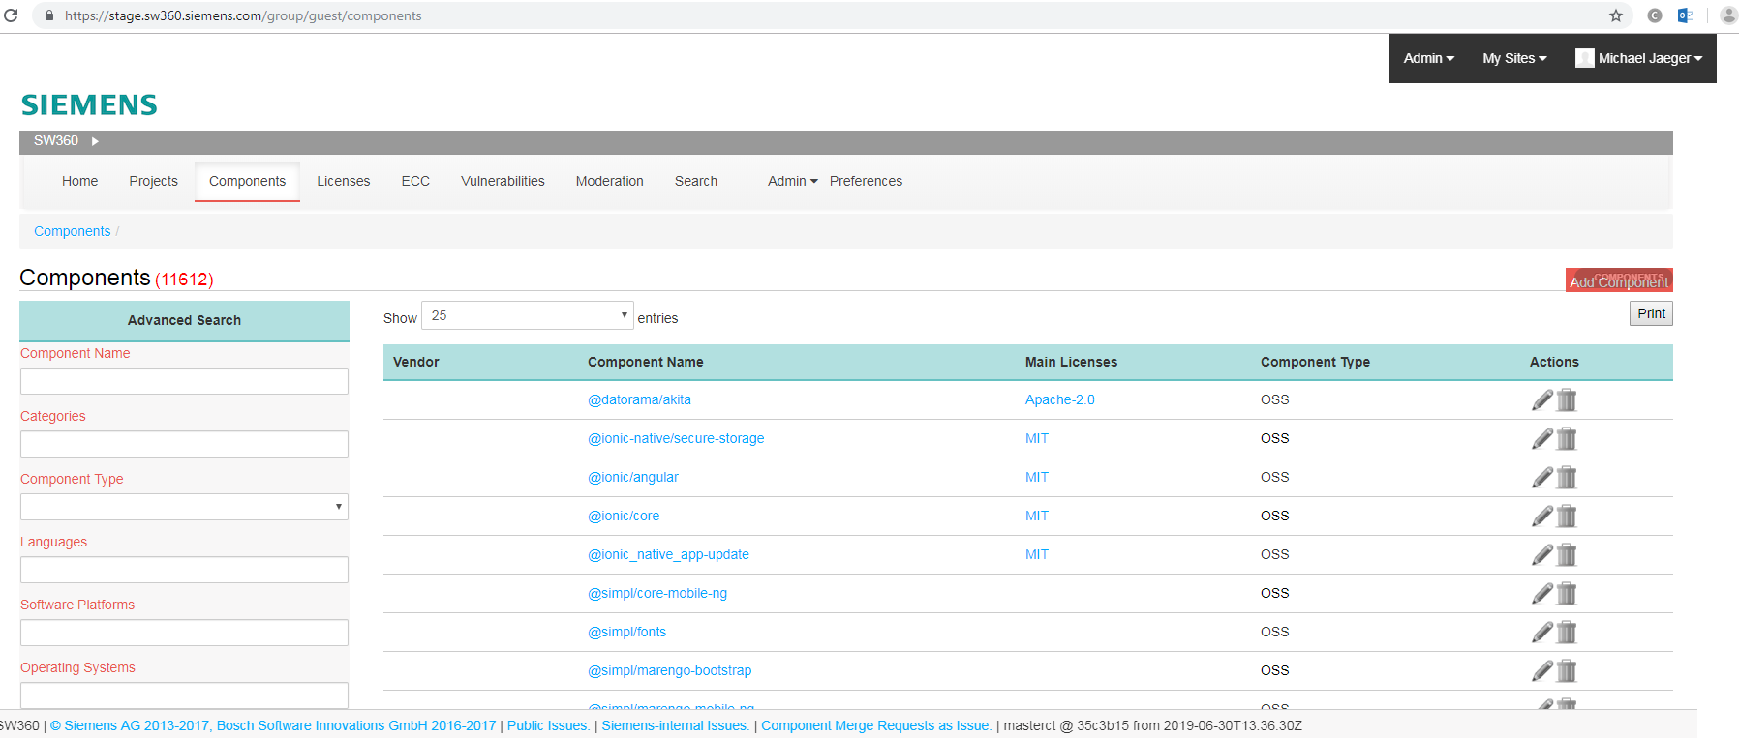
Project Updates – SW360, moving from Liferay 6

Slide 10
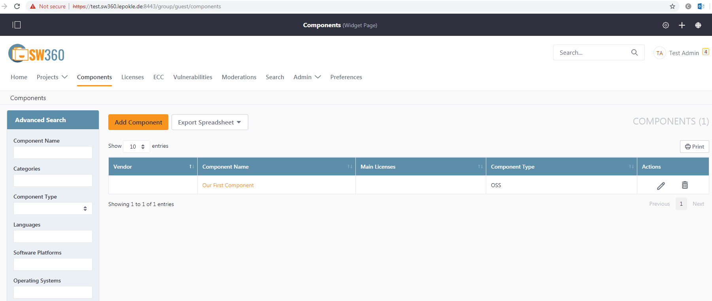
Project Updates – SW360, … to Liferay 7

Slide 11
Project Updates – Eclipse SW360Antenna
(please see separate slides)
www.eclipse.org/sw360antenna

Slide 12
Project Updates - FOSSology
News since Last Meeting (April 2019)
https://www.fossology.org
3 Google Summer of Code Slots, three projects
Integration with Software Heritage
Integration with Clearly Defined
Integration of Atarashi

Slide 13
Project Updates – Vulas
News since Last Meeting (April 2019)
https://sap.github.io/vulnerability-assessment-tool/

Slide 14
Questions and Answers From the previous slots

Slide 15
Marketing, New Members,
Upcoming Conferences

Slide 16
OSS-based OSS Compliance Tooling (Reference)
Infrastructure
Files at Github: https://github.com/Open-Source-Compliance/Sharing-creates-value
Project Wiki: https://github.com/Open-Source-Compliance/Sharing-creates-value/wiki
Mailing list:
https://groups.io/g/oss-based-compliance-tooling
Please consider mailing list: maintaining collection of E-Mails is really error-prone
Remember that mailing list is public

Slide 17
OSS-based OSS Compliance Tooling
New Members
Maybe mailing list voting is not appropriate
Alternative is to have approval for posting
Making archive public?

Slide 18
OSS-based OSS Compliance Tooling
Performed Talks
Legal Workshop of FSFE
Accepted general proposal (Mirko, Marcel, Oliver, Michael and Michael)
Larger number of statements in termin of tooling
Demand is interoprability between efforts
Demand is reducing manual efforts
Individual presentation about tool projects
SW360, SW360Antenna, FOSSology, FOSSologyML, Quartermaster

Slide 19
OSS-based OSS Compliance Tooling
Upcoming conferences
Proposal to Open Source Summit Europe, October 2019
Proposed presentation about general OSS Tooling effort and TODO group (Michael and Michael)
Proposed presentation about general OSS tooling and this fits (Lars)
Proposal to Open Source Summit NA,
ORT, Linux Handson, FOSSology project update, FOSSology hands on
EclipseCon Europe
Proposed OSS Cmpliance Toolng Best Practise (Marcel), Deadline still open until Jul 14th.
Proposed Vulas (SAP)
Buidlin a complaince toolchain with Eclipse technoloy (Lars)
ApacheCon, Berlin October 2019
Proposed License copliance and trustable software (Martin)
OpenInfra Days October 2019 Stockholm (Martin Submitted)
FOSS Backstage: call will open on August, opportunity to submit something
Any other (in future)
LF‘s Compliance Summit, December 2019

Slide 20
Lunch at 12:30

Slide 21
Data Model Discussion

Slide 22
Data Model
Enabling Interoperation
In the Github
https://github.com/Open-Source-Compliance/Sharing-creates-value/tree/master/Tooling-Landscape/Unanimous-Understanding/Data%20Structures

Slide 23
Tooling Efforts Landscape

Slide 24
Double Open
Separate Presentation
https://www.doubleopen.org/

Slide 25
Different Other Efforts
On OSS License Compliance Tooling
OpenChain
OpenChain Japanese WG
https://github.com/OpenChain-Project/Japan-WG-General
FINOS
https://github.com/finos-osr/OSLC-handbook

Slide 26
Wrap Up and Closing

Slide 27
Wrap Up and Closing
Next meeting
Volunteering to host next meeting?
Narrow down time frame for Doodleing
Proposal: the two weeks before Eclipse Con
Next Steps
Refer to documentation

Slide 28
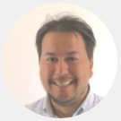
Thank you for your attention … questions?
Michael C. Jaeger
Siemens AG Corporate Technology Otto-Hahn-Ring 6 81379 München
michael.c.jaeger@siemens.com
FOSSology links https://code.siemens.com/fossology/fossologyng
https://github.com/fossology/fossology
SW360 links https://code.siemens.com/sw360/sw360portal
https://github.com/sw360/sw360portal
Notes:
Notes <number>

